Slide 1
Storyboard
Hospitality

Slide 2
Structure
Login
Forgot-password
Register
Homepage
Profile
Find Services
Remainders
Appointments
Call for help
Send Feedback
About the app

Slide 3
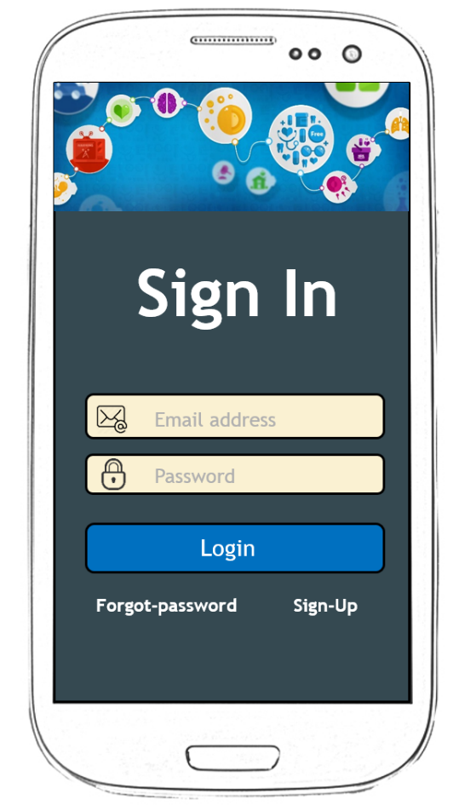
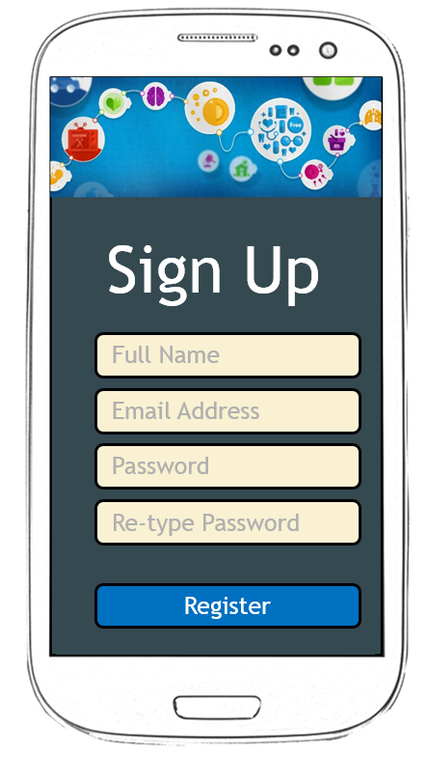
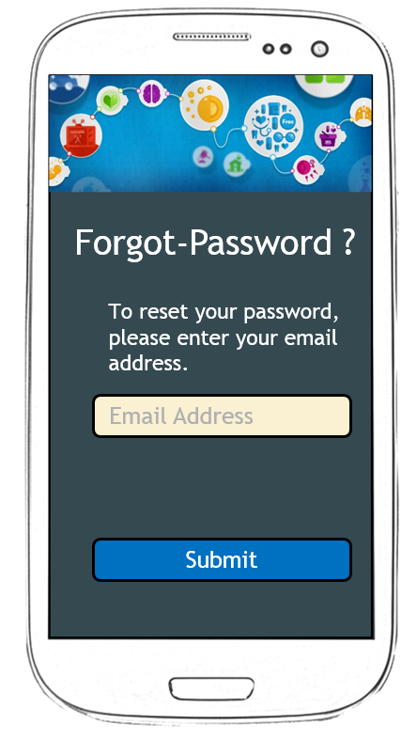
Sign Un, Sign In and Forgot Password Screen

Slide 4















Home Page
Home
Home
Profile
Find Services
Loading ..
Remainders
Appointments
Call for help
Useful Links
Send Feedback
About the app

Slide 5





Profile
Profile
Change Picture
Jomin George
Last Login: Thursday, February 29, 2016, 15:20:13
Gender
Language
Email Address
Contact Number
Done

Slide 6








Find Services
Find Services
Hospital
Pharmacies
Walk-in Centre
Fracture Clinic
GP
Dentist
Eye-care
Sexual Health

Slide 7

Find Services
Send Feedback
We greatly value your feedback to help us maintain our features to the best. You could make a real difference to our service and it would really help us understand what we have to do in order to give a better service to our customer.
Write your feedback
Submit

